Slide 1
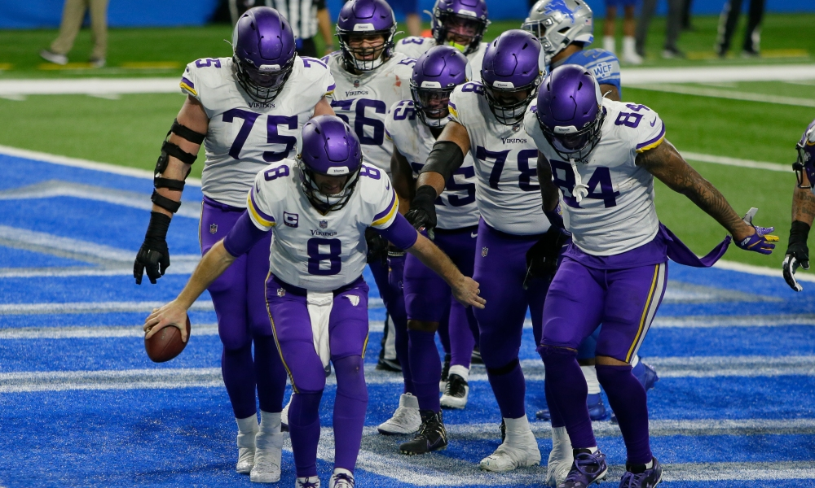

VIKINGS ADVISORY BOARD (2022 PERSONNEL)

Slide 2
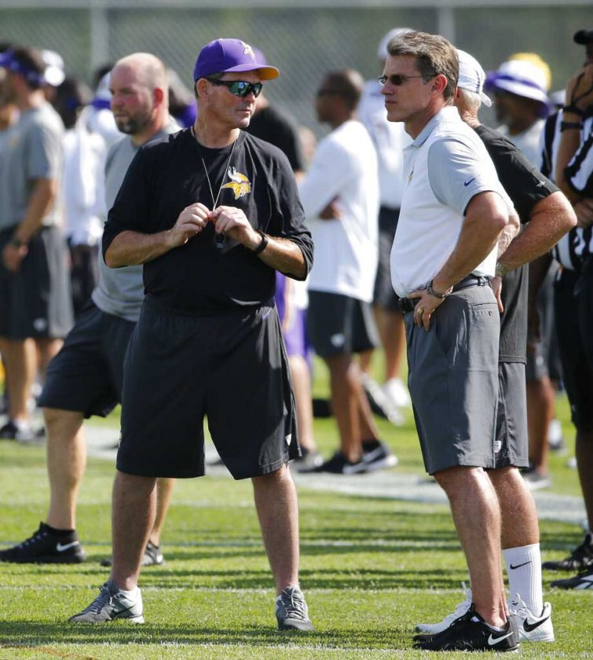
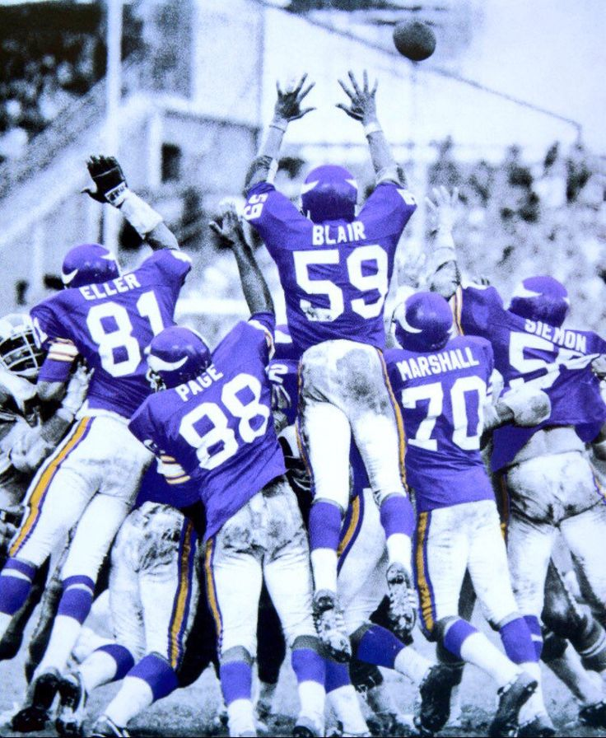
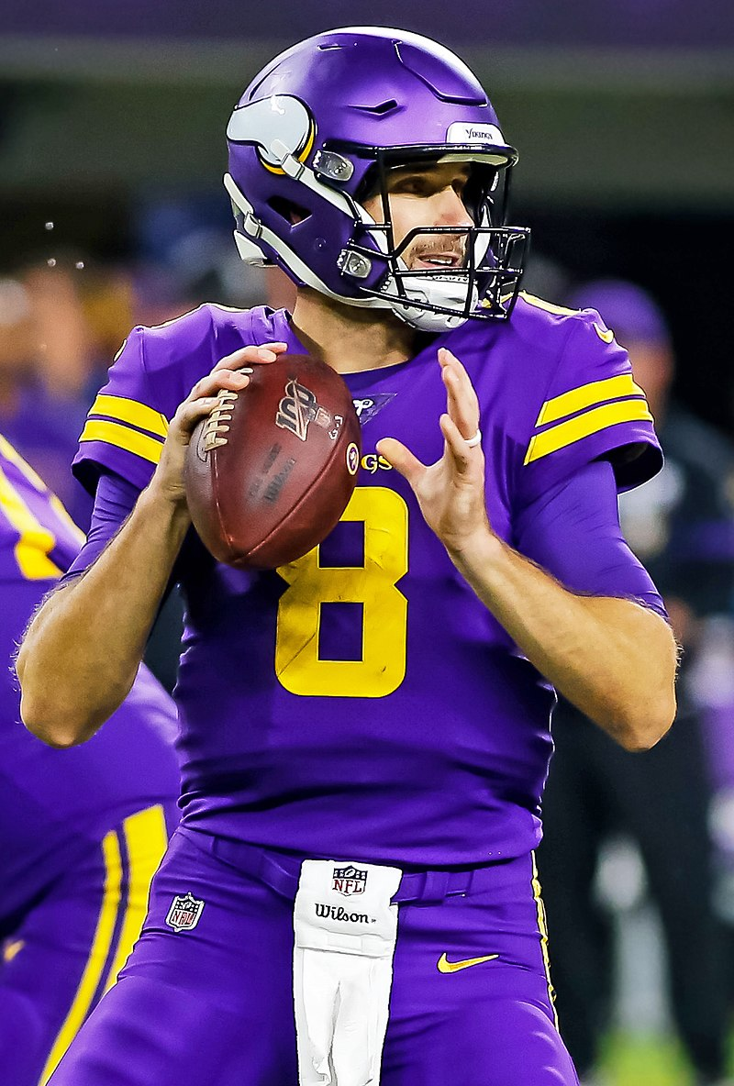
Minnesota Vikings Timeline
2018 – Kirk Cousins Signed to an 84 Million Dollar contract
Founded in 1960.
The 7th Highest Win % of the 32 NFL Teams
2012 – Rick Spielman Became general manager
2014 - Hired Mike Zimmer as head coach

Slide 3
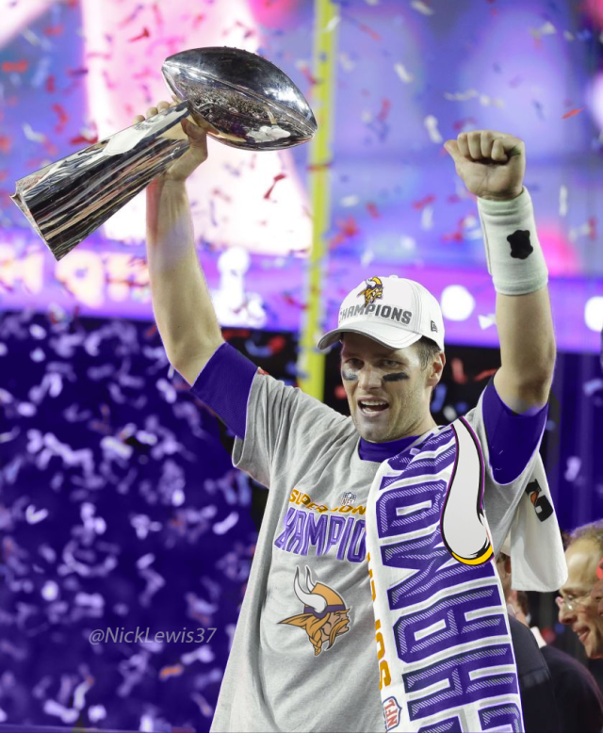
Our vision and goal: Super Bowls
The Vikings have been to 4 super bowls, losing each one
Have not returned since 1977 (45 years)

Slide 4
In the next 10 minutes…
Our goal:
Understand how the Minnesota Vikings’ success rate compares to Super Bowl winning teams
Use this knowledge to inform personnel decisions
We will end with a specific recommendation.

Slide 5
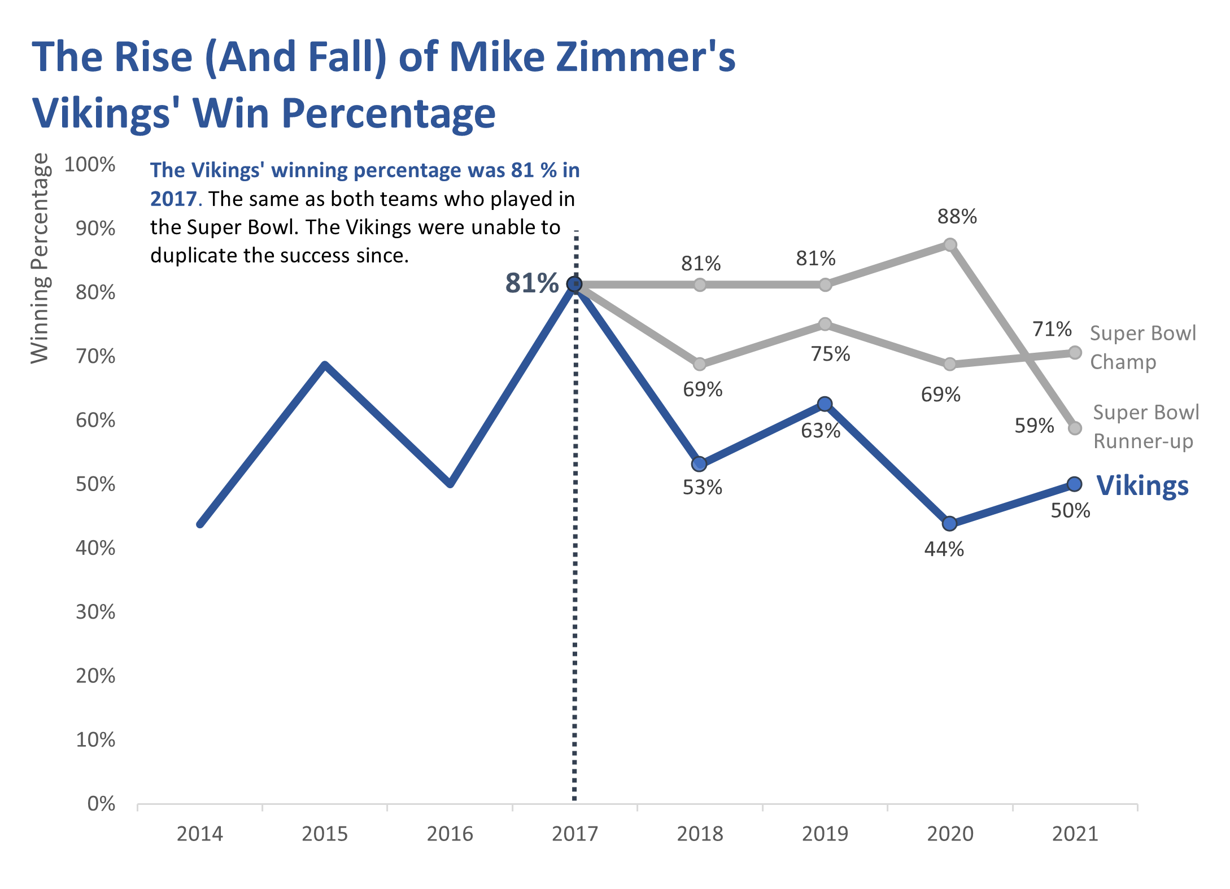

Slide 6
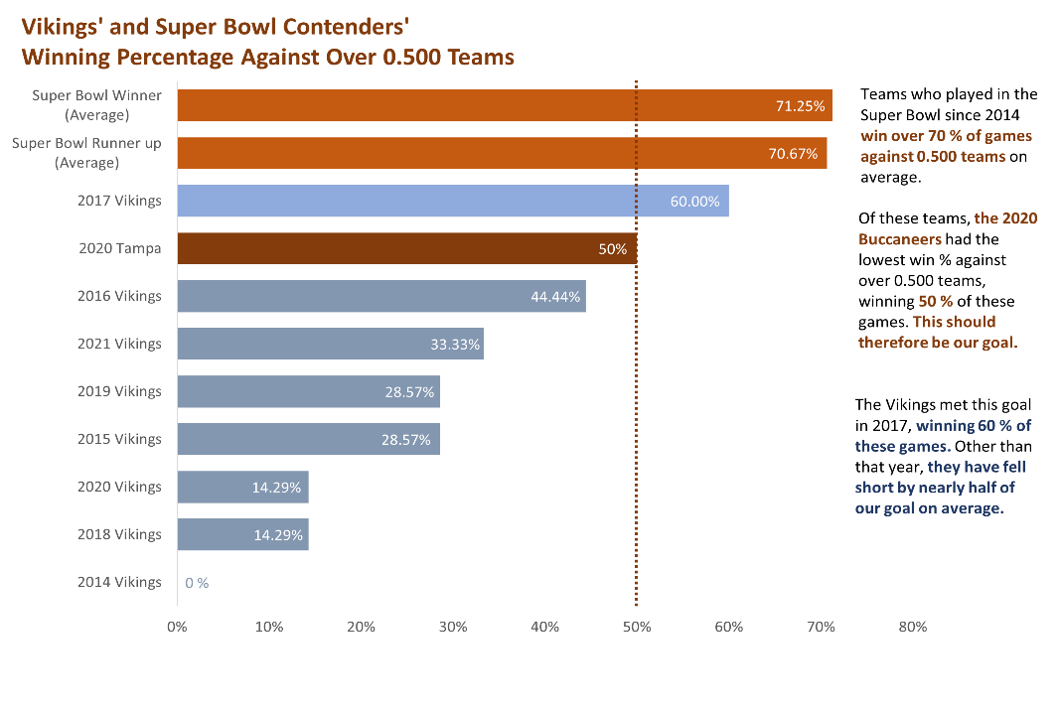

Slide 7
34 Years
Using our previous win percentages and rate making the playoffs as probabilities, we may expect to win the Super Bowl every 34 years.

Slide 8

Which statistics matter?
How analysis is done (correlation, statistical models)
The problem with using points and yards to predict wins
The most significant statistics to predict wins, per our analysis:
Offensive statistic: Net yards per pass attempt
Defensive statistic: Defensive points allowed per 100 yards
Nearly across the board, offensive statistics were more correlated with wins than defensive statistics

Slide 9
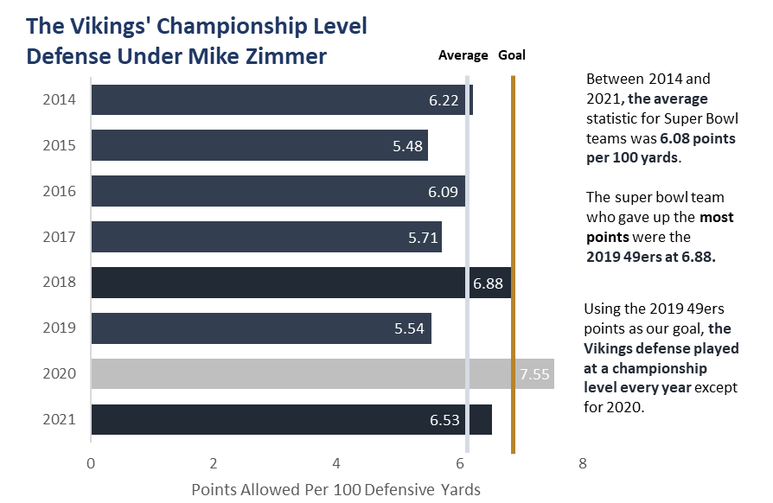

Slide 10
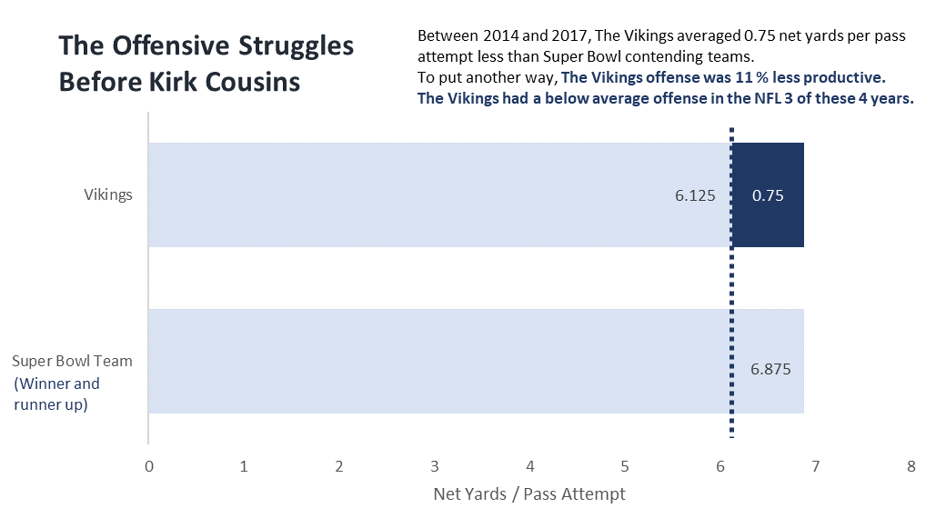

Slide 11
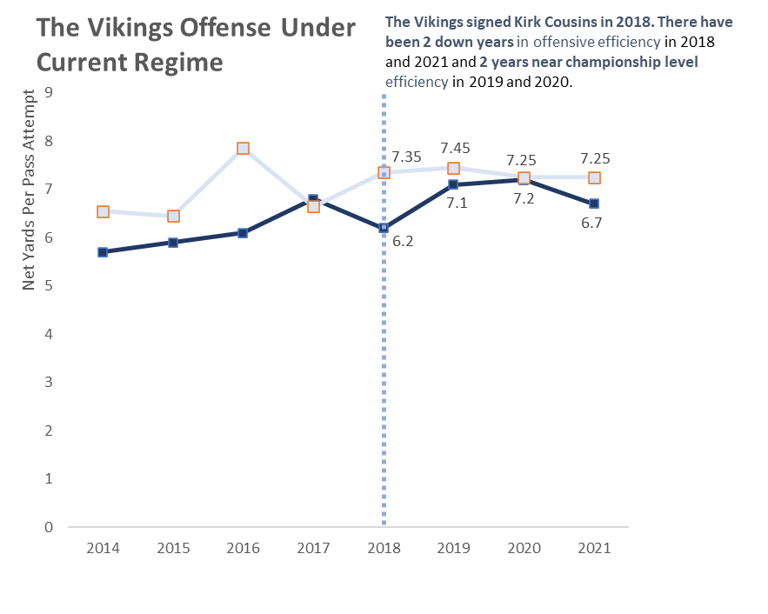
Super Bowl Teams
Vikings

Slide 12
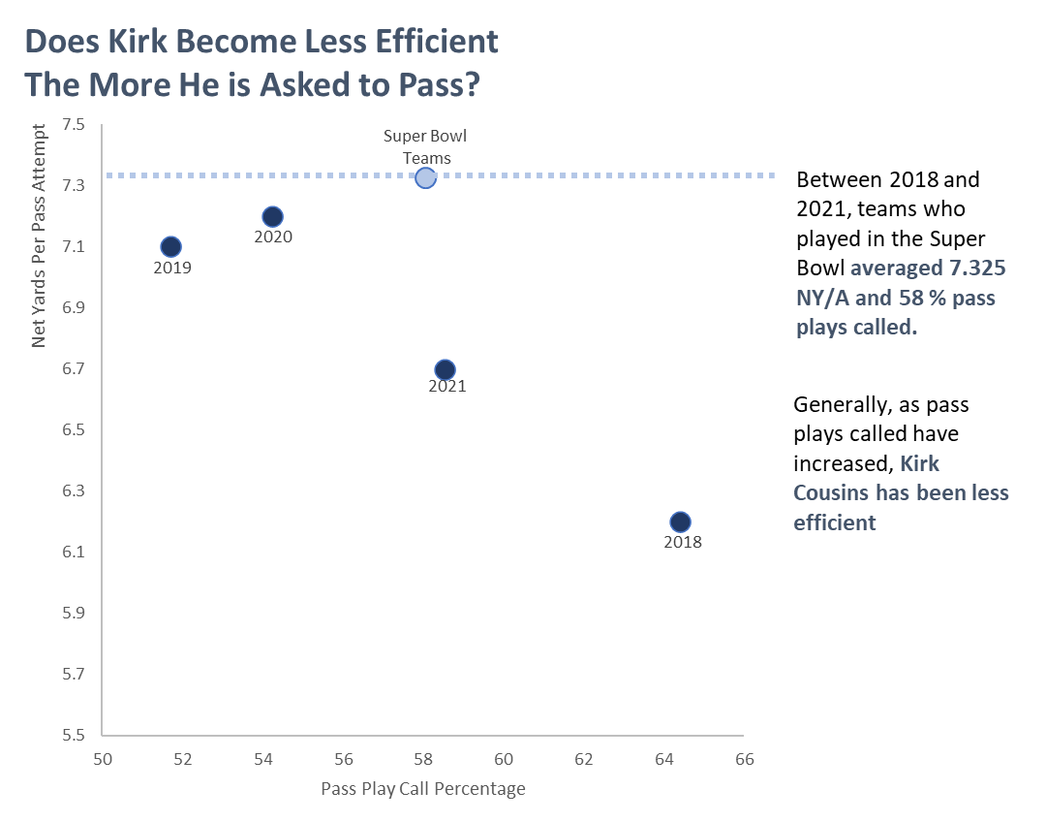

Slide 13
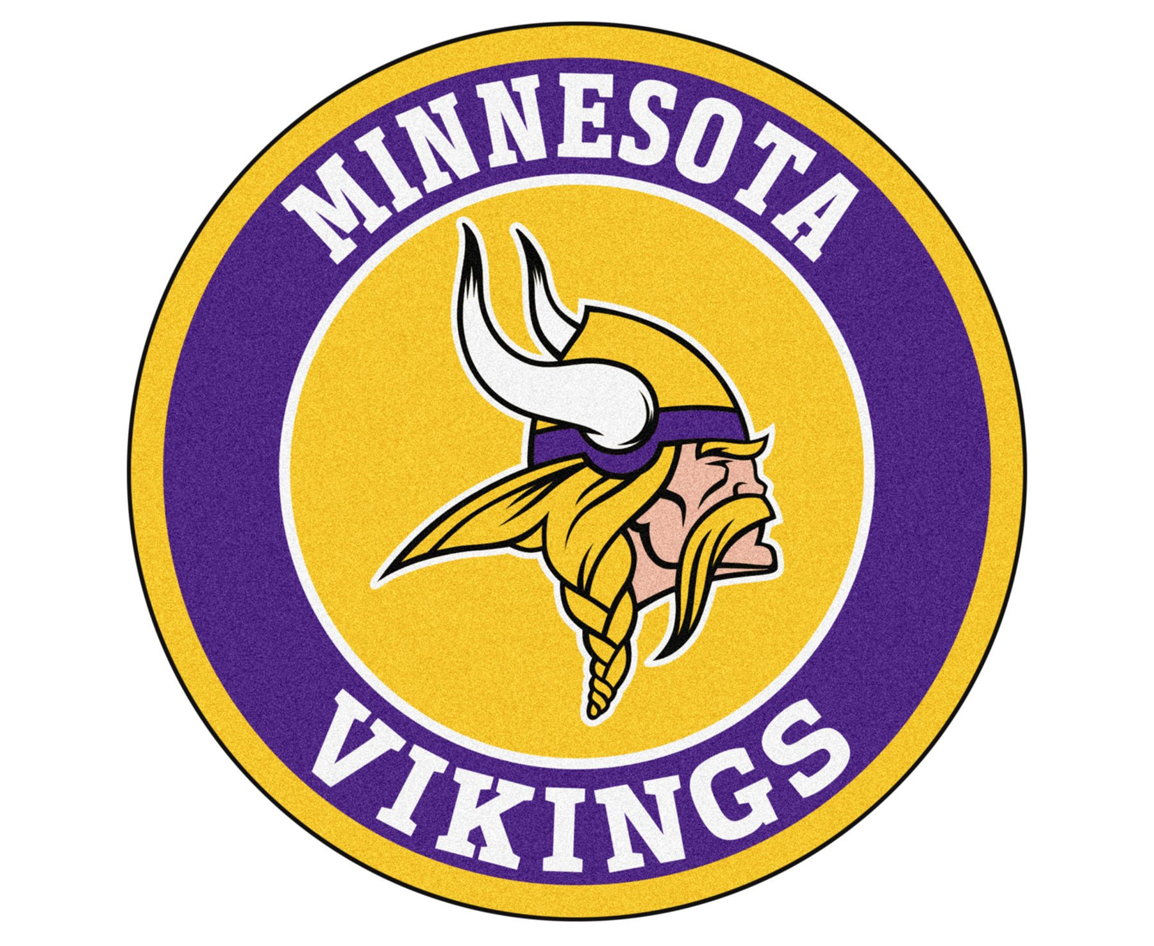
RECOMMENDATION
Due to the offensive inefficiencies and record against winning teams in our large 8 year dataset, I recommend moving on from:
Head coach Mike Zimmer
General Manager Rick Spielman
As for Kirk Cousins:
He has been inconsistent, but near championship level efficiency in 2 of his 4 years

